Slide 1
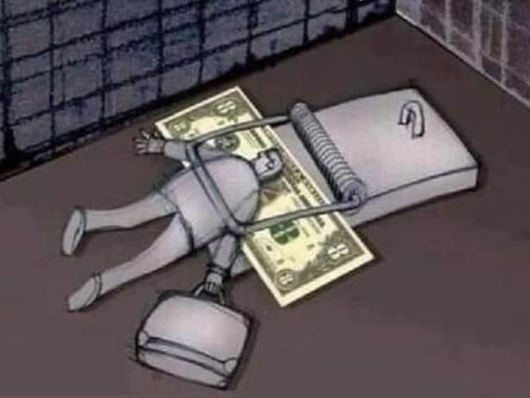
Surah Takathur
Negative Abundance
Competition
102

Slide 2
COMPOSITION
Compilation
102
Revelation
16
Ayah
8
Words /Letters
28 / 123
Juz
30
Rev. Period
Early Makkan
Classification
Mufassalat

Slide 3
T H E M E
Surah At-Takathur is among the cluster of 4 surahs: 99-102 (Zilzal, ‘Adiyat, Qaari’ah, Takathur) that follow a pattern of Qiyamah, Duniya, Qiyamah, Duniyah. This surah covers the following two themes:
Man’s strong desire for worldly wealth. The extreme tendency of human beings towards this world .
Consequences of running after worldly wealth. Lovers
of this world will be aware of the truth of what they
did after seeing the Hell

Slide 4
VIRTUES
According to the Holy Prophet (S)
"He who recites it, Allah will not account the bounties he was given in the world, and He will award him such a reward as if he had recited one thousand ayaah (of the Qur'an).
“The recitation of this Surah in the obligatory and optional prayers has a reward similar to Martyrdom.”
It is obvious that these total rewards are for the one who recites it, practices it in his daily life and harmonizes his mind and soul with it.

Slide 5
1
اَلۡهٰٮكُمُ التَّكَاثُرُ‏ 
The competition to increase
Diverts you
Lahw essentially means entertainment of any form and it is this Lahw that keeps us busy and deviated from things that actually need our attention and interest
Deviations: Alha – Ilha – Lahw – Lahwan - Tulhikum
The principal message in this word is that you are
wasting your time on something that is less important, when you could be doing something
a lot more important.

Slide 6
1
اَلۡهٰٮكُمُ التَّكَاثُرُ‏ 
The competition to increase
Diverts you
Takhathur Deviations Kathra – Katheer [ a lot – plentifulness ]
Desire of having a lot
Worldly / Materialistic stuff: Car, Home, Devices
Competing with others in getting a lot Latest version of cell phone than friends
Being arrogant about having a lot
My house has twice the square footage
Wanting more and more
Have an iphone, now want iWatch, Airpods

Slide 7
حَتّٰى زُرۡتُمُ الۡمَقَابِرَ‏ 
2
The graves
You visit
Until
Zurtum: Comes from Zaara or Ziyaara
Ziyaara means to go to meet someone for a temporary visit. Generally, ziyaara is used with a visit to a tomb.
Graves are temporary, before a permanent trip to Jannah or Jahannam

Slide 8
حَتّٰى زُرۡتُمُ الۡمَقَابِرَ‏ 
2
The graves
You visit
Until
Some commentators believe that the use of the term Maqaabir (plural of Maqbara – Tomb) instead of Quboor (plural of Qabr – Grave) is pointing to the fact that there were tribes who would compete with everything; more people, better weapons, even better dead people pointing at the graves and say - "do you have someone like that person?"

Slide 9
3
كَلَّا سَوۡفَ تَعۡلَمُوۡنَ‏ 
You will know
Soon
Nay!
4
ثُمَّ كَلَّا سَوۡفَ تَعۡلَمُوۡنَ‏ 
You will know
Soon
Nay!
Then
According to Hazrat Ali Ibn Abi Talib, "People are sleeping and when they die - they wake up." In other words, men will only realize how they wasted their life away, after death.
According to some scholars,
Ayah 3: When you enter the grave, you will find out the reality.
Ayah 4: When, 2nd time, you come out of the graves on Judgment Day.

Slide 10
5
كَلَّا لَوۡ تَعۡلَمُوۡنَ عِلۡمَ الۡيَقِيۡنِ‏ 
(Of) certainty
(with) a knowledge
You know
If
Nay!
‘Knowledge' contrasts with 'ignorance'. In other words, it is referring to 'the clarity and positiveness of something'.
'Certitude' (yaqin) is the opposite case to 'doubt'.
According to what is understood from the Islamic narrations and traditions, one of the strongest features of Faith is called 'yaqin'.

Slide 11
5
كَلَّا لَوۡ تَعۡلَمُوۡنَ عِلۡمَ الۡيَقِيۡنِ‏ 
(Of) certainty
(with) a knowledge
You know
If
Nay!
YAQIN
TAQWA
EMAAN
ISLAM

Slide 12
لَتَرَوُنَّ الۡجَحِيۡمَ‏ 
6
The Hellfire
Surely you will see
LA: used to respond to an oath. It is a qasam - for certainty.
لَتَرَوُنَّ الۡجَحِيۡمَ‏ 
6
The Hellfire
Surely you will see
Jaheem comes from Juhm which is the stare of a lion when it is about to pounce on his prey.
The stare makes the potential prey petrified/horrified - so it cannot move. Hence the meaning: You will see - the stare of the hunting hell.

Slide 13
7
ثُمَّ لَتَرَوُنَّهَا عَيۡنَ الۡيَقِيۡنِ‏ 
(Of) certainty
(with the) eye
Surely you will see
Then
So, if you will only believe it through seeing it - then you will see it, and when you see it
That is when you will go into it.

Slide 14
8
ثُمَّ لَـتُسۡـئَـلُنَّ يَوۡمَـئِذٍ عَنِ النَّعِيۡمِ‏ 
Surely you will be asked
The
pleasures
about
That Day
Then
1. Tus'aloona
You will be asked for sure.
2. La Tus'aloona
You will certainly be asked.
3. La Tus'alun-na (with a shadda)
Certainly, you will certainly, certainly be asked.

Slide 15
8
ثُمَّ لَـتُسۡـئَـلُنَّ يَوۡمَـئِذٍ عَنِ النَّعِيۡمِ‏ 
Surely you will be asked
The
pleasures
about
That Day
Then
Ni'mah (Singular) – Ni’am (Plural)
Na'eem - has a Ya in it means 'extra continuous comforts.'
You will be asked because you were in a state of continuous blessing. What did you do with those luxuries?

Slide 16
CONSLUSION
This beautiful surah began with the word, TAKATHUR – the one that we run after, and which distracts us
And the surah ends with NA’EEM –
The blessings that we keep ignoring which are the means of getting closer to Allah (SwT)
https://www.tazkira.info

Slide 17
All you have to do is ….
& Allah will …
KNOCK
ATTEND
ASK
REPENT
CRY
OPEN
WELCOME
GIVE
FORGIVE
LISTEN

Slide 18
QUIZ TIME

Slide 19
Which of the following is not a derived meaning of the name of this surah?
The mutual rivalry
01
A
Competition
B
Negative Abundance
C
Staring at the Hellfire
D

Slide 20
According to the period of revelation, Surah at-Takathur is considered to be a/an ______ surah.
Early Makkan
02
A
Mid Makkan
B
Late Makkan
C
Madani
D

Slide 21
The term, Lahw, means …
Lies
03
A
Entertainment
B
Abundance
C
Purity
D

Slide 22
Which of the following is not mentioned as a form of certitude in the Holy Qur’an?
Hubb-ul Yaqin
04
A
Haqqul Yaqin
B
Ilm-ul-Yaqin
C
Ain-ul-Yaqin
D

Slide 23
Which of the following is the 3rd tier of faith?
Imaan
05
A
Taqwa
B
Yaqin
C
Islam
D

Slide 24
The root word used in this surah for the ‘stare of the hunting hell’ is …..
Taraw
06
A
Juhm
B
Tus’alun
C
Takathur
D

Slide 25
Surah Takathur is among the cluster of ---- surahs that discuss the alternate theme of Day of Judgment and Worldly affairs.
One
07
A
Three
B
Four
C
Five
D

Slide 26
Which of the following words is not repeated in Ayaah 3 and 4?
Thumma
08
A
Kalla
B
Sawfa
C
Ta’lamun
D

Slide 27
Surah Takathur talks about the evil consequences of …
Stinting
09
A
Backbiting
B
Materialism
C
Hoarding
D

Slide 28
According to Surah Takathur, what will we be asked about on the Day of Qiyamah?
Level of Faith
10
A
Knowledge
B
Our parents’ rights
C
The delights
D

Slide 29
Answers:
1=D , 2=A , 3=B , 4=A , 5=B , 6=B , 7=C , 8=A , 9=C , 10=D

