Slide 1
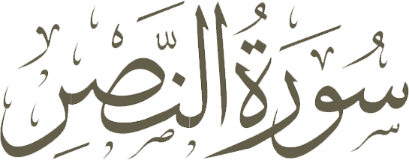
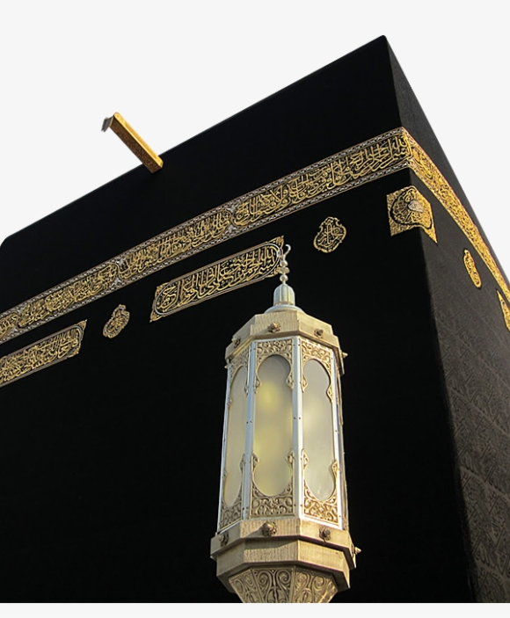
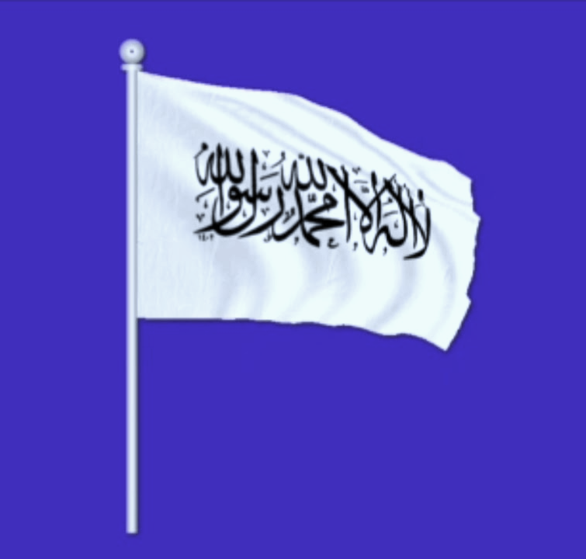

Slide 2
بس پاکی بیان کریں
تعریف کے ساتھ اپنے رب کی
اور اس سے بخشش طلب کریں
بیشک وہ ہے
بڑا توبہ قبول کرنے والا
جب
آجاۓ
اللہ کی مدد
اور فتح
فَسَبِّحۡ
بِحَمۡدِ رَبِّكَ
وَاسۡتَغۡفِرۡهُ​
اِنَّهٗ كَانَ
تَوَّابًا
اِذَا
جَآءَ
نَصۡرُ اللّٰهِ
وَالۡفَتۡحُ
اور آپ دیکھیں
لوگ داخل ہو رہے ہیں
اللہ کے دین میں
فوج در فوج
وَرَاَيۡتَ
النَّاسَ يَدۡخُلُوۡنَ
فِىۡ دِيۡنِ اللّٰهِ
اَفۡوَاجًا
3
2
1
Then celebrate the praise of your Lord and seek His forgiveness, (for) surely He is Oft-returning (to mercy)
And you see people entering Allah's religion in multitudes
When there comes the help of Allah and victory

Slide 3
General Information
Current Order of Compilation
Location
Order of Revelation
Ayaah / Words / Letters
Revealed in
Classification
Other Names
Unique Root Words
109
30th Juz
18
03 / 19 / 80
Madani
Jam'i al-nuzul
al-Tawdī & Idha Ja'a
None

Slide 4
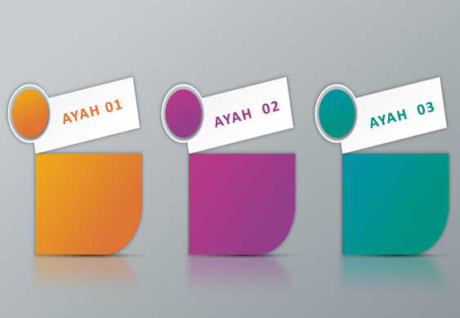
Content of the Surah
Conquest of Makkah by Muslims with the help of God
People's great welcome to Islam after the Conquest of Makkah
Duties of the Prophet (S) and Muslims after the conquest
SUMMARY
The chapter celebrates the Conquest of Makkah where there was no bloodshed, safety for all and the cleansing of the Ka’ba of its idols.

Slide 5
The Cleansing
The chapter begins with the cleansing of the external house (The Ka’ba) and ends with a directive of how to celebrate this victory which can only be done with the purification of the internal house (the heart) with declaring His perfection, gratitude and praise of Divinity and seeking forgiveness.

Slide 6
While there are many views about the occasion of the revelation, according to the most prominent commentators, this surah was revealed after Hudaybiyya peace treaty, before the Conquest of Mecca; thus, the victory and "the people entering Allah's religion in throngs" mentioned in the first and second ayaah refer to the conquest of Mecca; because it was after this victory that people accepted Islam in throngs.
Occasion
of the Revelation

Slide 7
3 News about the future
Conquest of Makkah with a great victory and a final domination of Islam
Acceptance of Islam by the people of Makkah and its surroundings and allegiance with the Prophet (S)
Demise of the Prophet (S)

Slide 8
Merits & Benefits
According to a hadith, anyone who recites four rak’as on the night of nineth of Sha'ban, and in each rak'a recites Surah al-Nasr ten times after reciting Surah al-Fatiha, Allah will prohibit fire to his body (meaning that he will never be punished in the hell) and for each ayah he recites, Allah will give him the reward of ten martyrs like the martyrs of the Battle of Badr and the rewards of religious scholars.

Slide 9
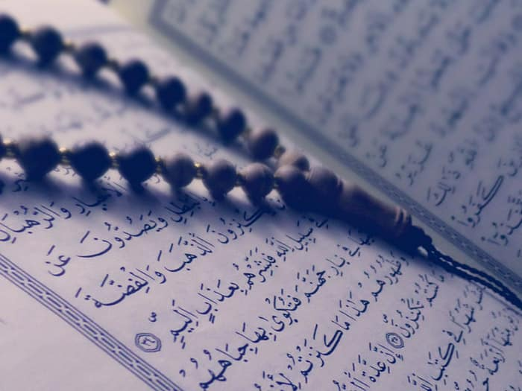
اِذَا جَآءَ نَصۡرُ اللّٰهِ وَالۡفَتۡحُ
jaa'a and 'ataa both mean “to come”, but jaa’a is used for something tougher and heavier.
Examples:
idhaa jaa'at as-saakhah [not used for something light]
jaa'a at-ttaamah al kubra [not used for something small]
Therefore
Idhaa jaa'a Nasrullahi wal Fath [ this Help from Allah is a great thing]

Slide 10
اِذَا جَآءَ نَصۡرُ اللّٰهِ وَالۡفَتۡحُ
There are many words in Arabic for “HELP”. Each defines a different type/level/shade of help. Some of these words are:
ista'ana, ayada, az'ara, madda, azazza, rafadda, dhaahara
What is Nasr?
Help needed against an oppressor to overpower them.
The enemies (Shaniak) of Surah Kawthar were referred to as Kafirun in previous surah. The Prophet (S) did not compromise and hence needed NASR from Allah (SwT)

Slide 11
ولی ۔۔ مولا
Allah’s Help (NASR) was bound to come, because, in Ayatul Kursi, it says
اللَّهُ وَلِيُّ الَّذِينَ آمَنُوا يُخْرِجُهُمْ مِنَ الظُّلُمَاتِ إِلَى النُّورِ
Allah is WALI of those who believe…...
Allah’s Help was coming against the oppressors, whose WALI is
وَالَّذِينَ كَفَرُوا أَوْلِيَاؤُهُمُ الطَّاغُوتُ يُخْرِجُونَهُمْ مِنَ النُّورِ إِلَى الظُّلُمَاتِ
and those who disbelieve their Awliyaa’ are taghoot……
a WALI is someone who is willing to protect you.
a MAWLA is someone who can protect you and actually does so.
Both believers and disbelievers have WALI,
but only believers have MAWLA.

Slide 12
Two Victories
There were 2 types of Fat-h in Makkah:
Fat-h hudaybia [the Victory of Hudaybia Treaty]
Muslims were officially recognized as a legitimate power
Fat-h al Makkah [the Victory / Conquest of Makkah]
No bloodshed, No violence, No taking advantage of people, No taunting, No show-off celebration
ONLY THANKING ALLAH
Now time to cleanup the Holy Ka’ba
Get rid of idols and images

Slide 13
The Gift of Allah
وَرَأَيْتَ النَّاسَ يَدْخُلُونَ فِي دِينِ اللَّهِ أَفْوَاجًا
Allah's Messenger was saddened that the people do not believe, so Allah is telling him that; you will see when people enter Islam in crowds.
Anyone, who had glimpse of humanity
left in them, entered Islam.

Slide 14
The Manifestation
فَسَبِّحۡ
بِحَمۡدِ رَبِّكَ
وَاسۡتَغۡفِرۡهُ​
اِنَّهٗ كَانَ تَوَّابًا
We manifest the directive of this surah in the two prostrations in Salah. In Sajda we declare His Perfection with Sub-haan and express our gratitude and praise with His Hamd. In between the prostrations we ask for forgiveness through Istighfaar.

Slide 15
The Final Word
The victory of Allah is great, but the
remembrance of Allah is greater!
R
R
R
Ramadan Recommended Recitation
Recite, [O Muhammad], what has been revealed to you of the Book and establish prayer. Indeed, prayer prohibits immorality and wrongdoing, and the remembrance of Allah is greater. And Allah knows that which you do. (29:45)
Surah Ankabut is one of the three recommended surahs to be recited during Shab-e-Qadr.

Slide 17
Question 01
Surah An-Nasr can be classified as …
A
B
C
D
Hamidaat
Jam'i al-nuzul
Musabbihat
Hawameem

Slide 18
Question 02
The duties of Muslims and the Holy Prophet (S) are defined in ….
A
B
C
D
Not defined in this surah
Ayah 01
Ayah 02
Ayah 03

Slide 19
Question 03
Other than Idha Ja’a and Nasr, what is another name for this surah?
A
B
C
D
Tawdī
Afwaja
Istighfar
Hudaybiyya

Slide 20
Question 04
The hadith about reciting this surah 10 times in each of the four rak’at is for the month of …
A
B
C
D
Ramadhan
Dhul Hajj
Rajab
Shaban

Slide 21
Question 05
Which of the following are ways to purify the internal house (the heart)?
A
B
C
D
Gratitude and Praise of Divinity
Declaring His Perfection
Seeking Forgiveness
All of the above

Slide 22
Question 06
The treaty of Hudaibiyya signed in Dhul-Qudaah 6AH was for a period of…
A
B
C
D
Fourteen Years
One Year
Three Years
Ten Years

Slide 23
Question 07
How many news are given in this surah about the future?
A
B
C
D
Two
Three
Four
Five

Slide 24
Question 08
Which of the following news has been given in ayah 2 as a gift for the Prophet (S)?
A
B
C
D
Mass acceptance of Islam
Wealth through battles
Treaty of Hudaybiyya
All of the above

Slide 25
Question 09
Other than Surah Ruum & Dukhan, which other surah is highly recommended to be recited during Night of Qadr?
A
B
C
D
Nasr
Fath
Ankabut
Bani Israel

Slide 26
Question 10
While the more comprehensive meaning of Taghout (from root word Tagha) is ‘to exceed the proper bounds or limits’, which of the following are also considered taghout?
A
B
C
D
All of the above
Stones
Idols
Shaytan

