Slide 1
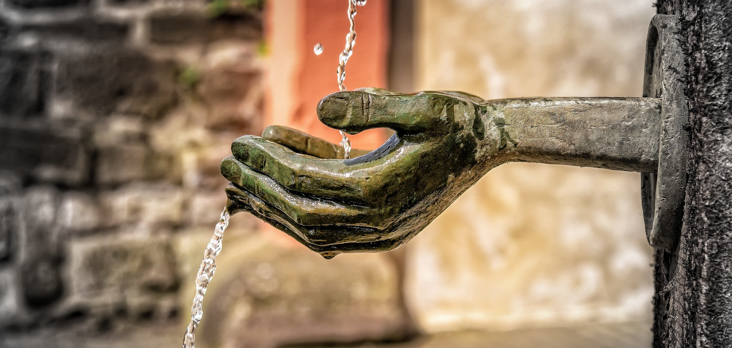
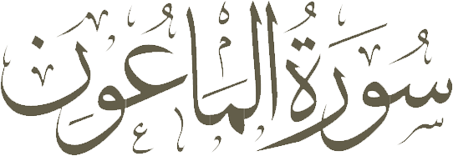
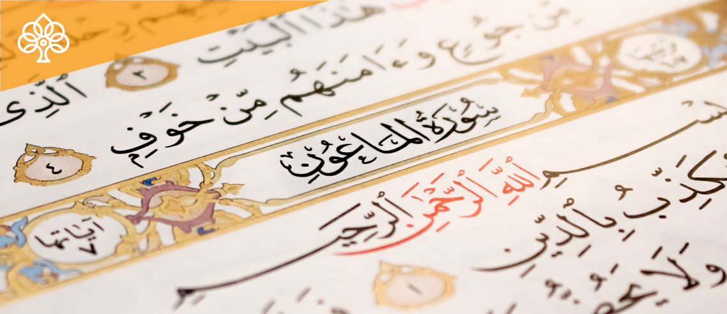

Slide 2
GENERAL INFORMATION
Current Order of Compilation
Location
Order of Revelation
Ayaah / Words / Letters
Revealed in
Classification
Other Names
Unique Root Words
107
30th Juz
17
07 / 25 / 114
Makkah
Early Makkan
Araʾayta al-ladhī & Ad-Deen
1 (mīm ʿayn nūn)

Slide 3
SURAH CONTENT
AYAH 01
AYAH 02-03
The Holy Prophet (S) is addressed and some unfortunate reflections of the denial of the Hereafter, in the deeds of the rejectors, are expressed.
Not observing the rights of people in the lower class of the society
SIGNS OF PRETENTIOUS BELIEVERS
AYAH 04-06
AYAH 07
Not observing the right of God to be worshiped
Being inattentive to other people's needs

Slide 4
RELATIONSHIP TO THE PREVIOUS SURAH (1)
The previous Surah, Quraysh, concludes on a demand on Quraysh that they should enslave themselves fully and worship the Master of this house (the Ka’ba).
Allah tells them what they should be doing (enslaving themselves to Him.) In this Surah, Ma’un, Allah tells us what they are doing presently without Emaan (Belief). A contrast between what they should be doing, and what they are doing instead.

Slide 5
RELATIONSHIP TO THE PREVIOUS SURAH (2)
POSITIVE REINFORCEMENT in Surah Quraysh
Allah mentions His favors on Quraysh, and due to His favors upon them – they should enslave themselves and submit to their Merciful Master.
NEGATIVE REINFORCEMENT in Surah Ma’un
The Quraysh, however, did not become Muslim – so Allah criticized them in this surah for their evil acts. He comments on the reality of their behavior without Islam.

Slide 6
THE TONE OF THE SURAH
This surah is a sharp, intelligent, uncompromising, unapologetic depiction of social corruption in that society.
Allah’s Messenger is not in social or political power in Makkah, and for him to criticize and point direct fingers at the leaders who have power to harm – requires full trust in Allah.

Slide 7
THE OCCASION OF REVELATION
With respect to the occasion of the revelation of Surah al-Ma'un, it is said to have been revealed about Abu Sufyan. He slaughtered two big camels for himself and his friends every day. One day, an orphan went to him and asked him for some help, but Abu Sufyan hit him with his cane and made him stay away.
Some others have said that the ayah was revealed about Walid bin Mughira or ‘As bin Wa'il.

Slide 8
THE MERITS OF RECITATION
If one recites Surah al-Ma'un after 'Isha prayer, God will forgive him or her and will protect him or her until the adhan of the morning prayer. ~ Holy Prophet (S)
If one recites Surah al-Ma'un after the Asr prayer, he or she will be protected by God until the next afternoon. ~Imam Sadiq (A)
If one recites Sura al-Ma'un in obligatory and recommended prayers, God will accept his or her prayer and fasting and will no longer inspect his or her actions. ~Holy Prophet (S)

Slide 9
Have you seen him who denies
the Final Judgement?
اَرَءَيۡتَ الَّذِىۡ يُكَذِّبُ بِالدِّيۡنِؕ‏
1
aRa’ayt: Did you see?
Used when Allah is empowering His Messenger in confidence and honoring him and his morality in comparison to the disbelievers.
a lam taRa: Did you not see?
Used when Allah’s Messenger was overwhelmed and extremely saddened that the leaders have power and media against the message of Allah and Allah is consoling him.
KAFIR vs MUKADHIB
alladhee yakfuru bid-deen – the one who rejects the religion. outright denial and rejection.
alladhee yukazibu bid-deen – the one who lies against the religion. The one who is doing takdhib – they are lying against the religion, saying it is a lie.

Slide 10
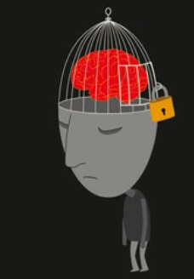
Deniers of Deen (MUKADHIB)
Mukadhib (Denier): One who knows that something is true but lies against it by choking and killing his conscience and rejecting it.
ATTRIBUTES RELATED TO
Humanity
Divinity
Reject ones without social standing
Do not assist or motivate in helping the needy
Refuse even small acts of kindness
Offer Salaat
As a habit with no spiritual connection with the Creator – a prayer of neglectfulness
To be seen in public – a show off

Slide 11
Then such is the man who repulses the orphan (with harshness)
فَذٰلِكَ الَّذِىۡ يَدُعُّ الۡيَتِيۡمَۙ‏
2
YATEEM – someone who lost their parents in childhood.
They feel depressed, hopeless, like there is no ground to stand on. These people are most in need of pity and courtesy.
When someone denies the Judgment Day and the next life, they deny a reality that Allah placed in their Fitrah (natural disposition). When one denies the reality – they lie against themselves, so their heart contradicts and contradiction in the self makes one at unease, making the heart feel harden and closed. When the heart goes hard – Mercy is lost and results in oppression of the weak and this makes them a disgusting person who even repulse and oppress innocent orphan.

Slide 12
And encourages not the
feeding of the indigent
وَ لَا يَحُضُّ عَلٰى طَعَامِ الۡمِسۡكِيۡنِؕ‏
3
MISKEEN – a poor person. (NOTE that SINGULAR is used here) for 2 reasons.
1. Forget many poor people, he doesn’t even encourage the feeding of one poor person (miskeen).
2. It makes the criminal remember the particular poor person they treated badly.
Allah is telling them that He knows what specific crime they did today against that poor.
Here, Abu Lahab, who was the treasurer, is criticized because treasurer has the duty to feed the poor and support the weak at an official level, but they do not fulfill their role. Instead of helping the needy, they were wasting money on rich.
Why doesn’t he encourage people to give to the poor?
If he encourages people to feed the poor – people will ask him why he doesn’t feed the orphan and poor himself?

Slide 13
فَوَيۡلٌ لِّلۡمُصَلِّيۡنَۙ‏
So woe to those praying ones
4
MUSALLIN – those who pray
Note that Allah did not use the term, Fa Waylun Lil Munafiqeen (Curse on the hypocrites), rather said Fa Waylun Lil Musallin (Curse on those who pray). This is a message for all of us to be terrified and reflect.

Slide 14
Who are careless of
their prayers
الَّذِيۡنَ هُمۡ عَنۡ صَلَاتِهِمۡ سَاهُوۡنَۙ‏
5
SAAHOOWN – Neglectful
Saahoown comes from the root word, Sahw. It means to forget something out of neglectfulness because something – of a greater thought to you – was on your mind.
Here those are described who are neglectful about their prayers. They neither consider any value for their prescribed daily canonical prayers, nor lay stress on its proper time, nor observe its conditions and rites.
Sajdah Sahw The prostration of forgetfulness (because your mind was thinking about something else).

Slide 15
Those who (want but) to
be seen (of men)
الَّذِيۡنَ هُمۡ يُرَآءُوۡنَۙ‏
6
RAA’A: Literally means “of two parties to struggle against the other”.
Here it means that they’re trying really hard to be seen while praying.
This refers to those who do these acts so others will think they are good and will spread the word that they are good people. This is a serious spiritual illness that can destroy the heart like cyanide destroys the body.

Slide 16
But refuse (to supply) (even) neighborly needs
وَيَمۡنَعُوۡنَ الۡمَاعُوۡنَ‏
7
MA’UN: Small acts of kindness
Referring to generally insignificant items, which these faithless people refuse to share with the needy.
The faithless ones are so stingy and miserly that they withhold even thing of insignificance from people, especially neighbors - things like salt, water, matches for fire, dishes, and the like, which are the necessities of life.
These little things, although may not cost much, but they are sometimes very helpful, so when they refuse to give them this produces some notable difficulties in the lives of people.

Slide 17
SO THE MESSAGE IS ….
Note that the ayaah related to Divinity are in the middle while the ayaah related to the humanity on either side.
So, the Message is …. That you have to be good to the people and good to Allah. You have to have a balance of a good relationship with Allah and the people.

Slide 18
LASTLY … YET ANOTHER CONNECTION
Allah is telling the leaders of the Quraysh (in Surah Quraysh)…. He who gave you food (at’amahum min joo’).
NOW ALLAH IS ASKING THEM
Are you not going to give even a little when Allah gave you everything you have?

Slide 20
Surah Al-Ma’un is an _________________ surah which is in Juz’ __________.
A
B
Early Makkan 29
Mid Makkan 29
QUESTION 01
Mid Makkan 30
Early Makkan 30
C
D

Slide 21
How many unique root words are there in Surah Al-Ma’un?
A
B
One
Two
QUESTION 02
Three
Four
C
D

Slide 22
Pick the other two names of Surah Al-Ma’un.
A
B
Saahoown
Araʾayta al-ladhī
QUESTION 03
Musallin
Ad-Deen
C
D

Slide 23
According to the majority of commentators, who was the person that pushed the orphan?
A
B
Abu Jahel
Abu Lahab
QUESTION 04
Abu Sufyan
Amr bin A’as
C
D

Slide 24
Which social problem has been highlighted in this surah?
A
B
Education
Poverty
QUESTION 05
Illiteracy
Corruption
C
D

Slide 25
A “Mukadhib” is the one who …..
A
B
Rejects
Denies
QUESTION 06
Lies
Boasts
C
D

Slide 26
Name the treasurer identified in this surah who did not encourage people to help the needy.
A
B
Abu Lahab
Abu Jahel
QUESTION 07
Abu Sufyan
A’as bin Wail
C
D

Slide 27
Those who are neglectful and do not care about their prayers are called __________ in this surah.
A
B
Musallin
Saahoown
QUESTION 08
Mukadhib
Kafir
C
D

Slide 28
According to this surah, relationship with Allah is incomplete without a good relationship with …..
A
B
Prophets
Angels
QUESTION 09
Relatives
The fellowmen
C
D

Slide 29
Which of the following is not considered Ma’un?
A
B
Salt
House
QUESTION 10
Milk
Knife
C
D

Slide 30
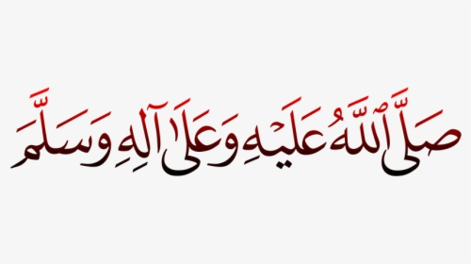
May Allah (SwT) give us taufeeq to be
His true servants!
Ameen.

