Slide 1
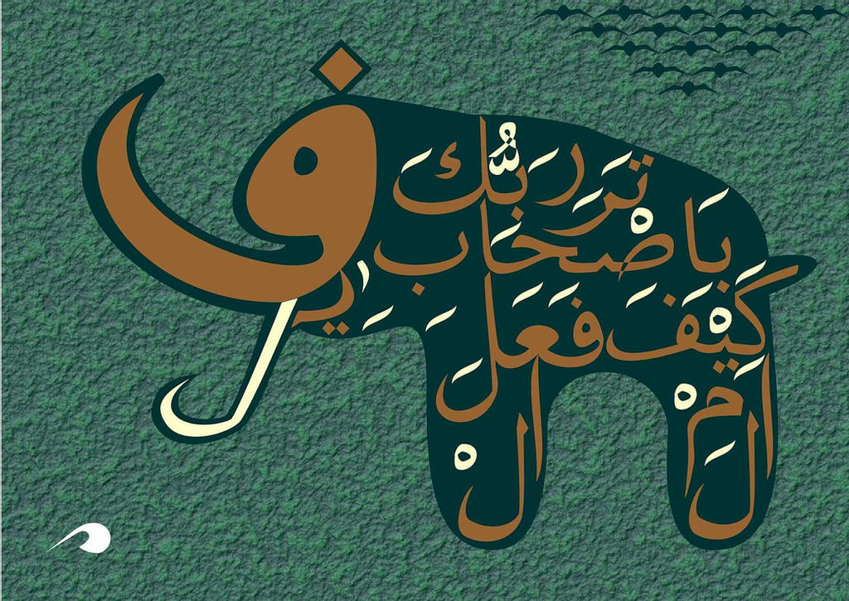

Slide 2
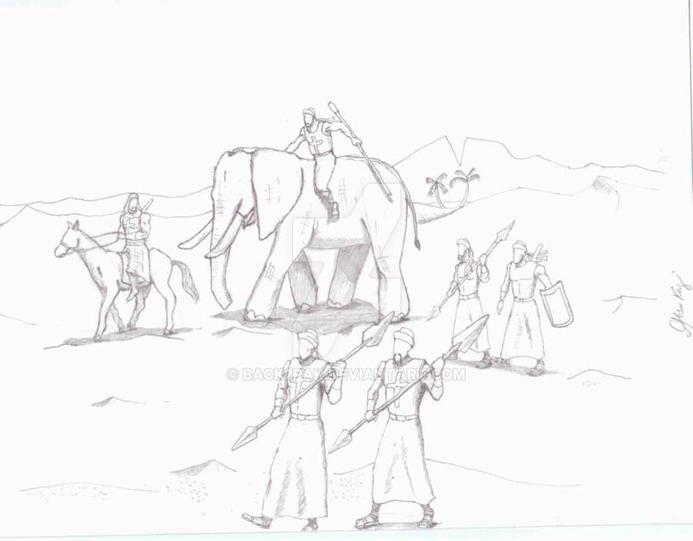
Surah Al-Fil
سورۃ الفیل
اَلَمۡ تَرَ كَيۡفَ فَعَلَ رَبُّكَ بِاَصۡحٰبِ الۡفِيۡلِؕ
Have you not seen how your Lord dealt with the army of the elephants?
ااَلَمۡ يَجۡعَلۡ كَيۡدَهُمۡ فِىۡ تَضۡلِيۡلٍۙ
Did He not make their tricks go awry
وَّاَرۡسَلَ عَلَيۡهِمۡ طَيۡرًا اَبَابِيۡلَۙ
And send against them flocks of birds
تَرۡمِيۡهِمۡ بِحِجَارَةٍ مِّنۡ سِجِّيۡلٍ
Pelting them with stones of shale
فَجَعَلَهُمۡ كَعَصۡفٍ مَّاۡكُوۡلٍ
Thus making them like chewed-up straw!

Slide 3
SURAH CONTENT
The inefficiency of the Army’s military mechanisms
1
The failure of the Army's plans and tricks
2
Recruiting small birds
3
Employing clods
4
The defeat of the Army of the Elephant by the Divine Power
5

Slide 4
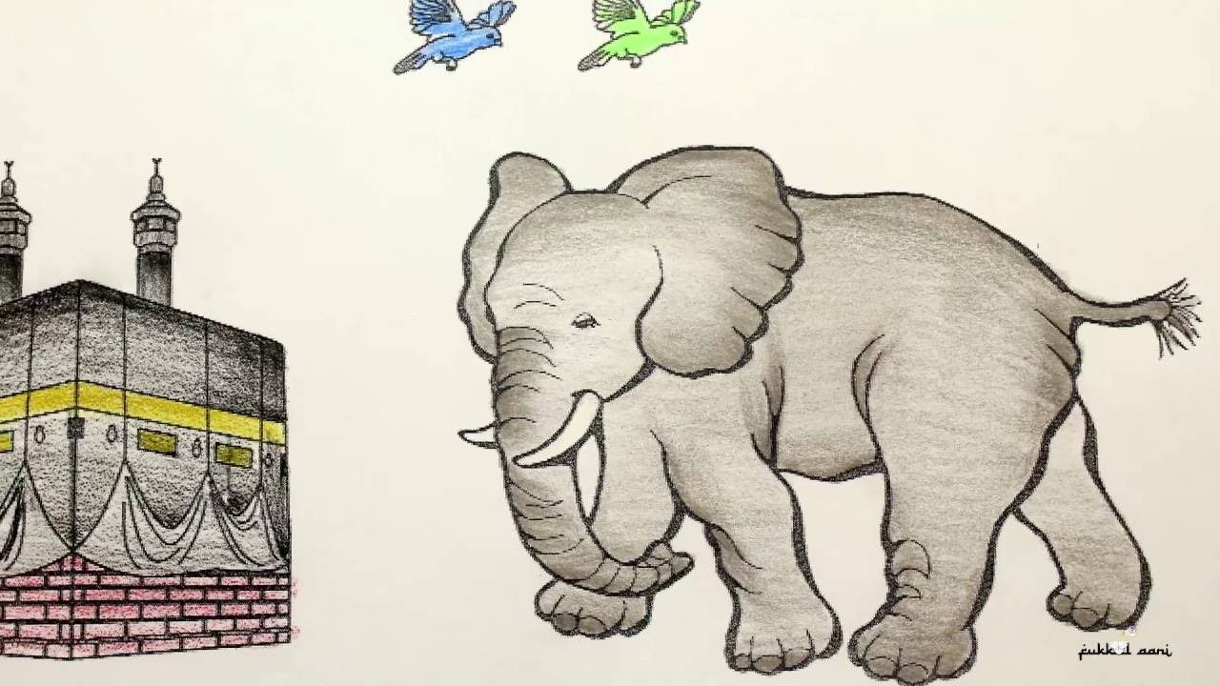
There is one Unique root word in this surah (fā yā lām)
Surah al-Fil is a Makki surah, and in its order of revelation, it is the 19th surah which was revealed to the Holy Muhammad (S). In the current order of compilation, it is the 105th surah located in the 30th juz. It has 5 ayah, 23 words and 97 letters.

Slide 5
NAME OF SURAH
Refers to the well-known historical event that happened in the year of the birth of the Holy Prophet (S) when Allah (SwT) protected the Holy Ka'aba against the attack of the army of pagans who, riding on the backs of elephants, came from Yemen intending to destroy it.

Slide 6
PAGANS KNEW ABOUT THIS EVENT
The event was fresh in the minds of the people of Makkah as it had happened the year of the birth of our Holy Prophet (S). This Surah is a recollection of the miraculous event which many people of Makkah remember, because it happened not so long ago. Its remembrance is a warning against the proud, arrogant pagans to make them aware that they have no power to stand in the way of the Power of Allah, Who destroyed that great army of elephants by little, tiny birds who pelted them with 'small stones of petrified clay' and He can punish these stubborn oppressors, too.
At any rate, this miraculous event was so important that that year was called /‘amulfil/ ‘the year of the elephant' and was known as a beginning date in the history of Arabs.

Slide 7
THE VIRTUE OF SURAH FIL
"He who recites Surah Fil in his obligatory prayers, any level land, mountains or any clods of dirt will bear witness for him, on the Day of Judgement, that he has been one of the prayerful (believers). It is obvious that these magnificent, abundant bounties and rewards are for he who, with its recitation, gets down from the horse of arrogance and goes on the right path along side which he seeks the satisfaction of Allah.

Slide 8
THE OCCASION OF REVELATION
The Quraish, hearing the details of Prophet’s (S) mission, as he was describing to his uncle, Hazrat Abu Taleb, became astonished and said to Hazrat Abu Taleb, “Do you not hearken to your nephew and what he says? By Allah, if Persians and Romans hear this, they will snatch us from our land and surely they will break the Ka'ba into pieces of stone”.
Hence, Allah sent down Surah Fil (in order to tell them that no one could break Ka’aba into pieces).

Slide 9
THE STORY OF ASHABUL FIL (1 of 10)
Zu-Nuwas, the king of Yemen, persecuted the Christians of Najran, who lived there, in order to force them to leave their Faith. The Qur'an has pointed out with the terms of /ashab-i-uxdud/ ‘the makers of the pit of Fire' (Surah Buruj, Ayah 85). After that terrible massacre, a man by the name of 'Dus' was able to escape and went for refuge to the Caesar of Rome, who was Christian, and described to him the event. Since there was a long distance between Rome and Yemen, Caesar wrote a letter to Najaishi, the king of Yemen, advising him to take revenge on the murder and sent the letter by the man, himself.

Slide 10
THE STORY OF ASHABUL FIL (2 of 10)
Najashi prepared an army of about seventy thousand men and sent them to Yemen under the leadership of 'Irbat'. Abrahah was also one of the commanders of that army. The army invaded Yemen and before long defeated Zu-Nuwas, and 'Irbat’ became the ruler of Yemen. But, after a short time, Abrahah rose against him and killing him, substituted Irbat.

Slide 11
THE STORY OF ASHABUL FIL (3 of 10)
The news reached Najashi who decided to punish Abrahah. Abrahah shaved the hair of his head and with some soil of Yemen sent this to Najashi as a sign of complete submission and loyalty. When Najashi understood the situation, he forgave him and retained him in his position. Then, to show his good behaviour and gratification, Abrahah had built a great, beautiful, splendid church unsurpassed in the world at that time. After that he introduced it as 'Ka'ba', to the people of Arabia, instead of the real Ka'ba and decided to make it the center for the Arab Haj pilgrimage and to transfer the great central place of gatherings of Mecca to that place.

Slide 12
THE STORY OF ASHABUL FIL (4 of 10)
For this purpose, he sent many preachers to different places and among the Arab tribes in Arabia. But, Arabs, who intensely loved Mecca and the Ka'ba and knew it as the greatest sign of Prophet Abraham, the Khalil (as), felt danger. According to some narrations, a group of people hiddenly burnt the church, and according to some other narrations some people hiddenly desecrated it and thus they showed their intense reaction against that vast invitation and discredited Abrahah's church. Abrahah became very angry and decided to destroy the Ka'ba, totally, both in order to take revenge, and to attract Arabs to the new temple. He set out to invade Mecca with an army which consisted of soldiers and elephants. Approaching the outskirts of Mecca, Abrahah's men captured 200 camels belonging to Abdul-Muttalib, the grandfather of the Holy Prophet (S).

Slide 13
THE STORY OF ASHABUL FIL (5 of 10)
Abrahah sent a man to Mecca to find the supreme chief of Mecca and tell him of his intentions of destroying the Holy Ka'ba and to inform the authorities that if they did not stand against him he would not kill anyone. The man arrived in Mecca and looked for the chief of the city. Everyone showed Abdul-Muttalib to him and he gave him the message. Abdul-Muttalib said that they were not in a position to fight with them and the Ka'ba would be protected by Allah, Himself.

Slide 14
THE STORY OF ASHABUL FIL (6 of 10)
The man told Abdul-Muttalib that he should accompany him to see Abrahah. When Abdul-Muttalib approached the military camp he was received, respectfully, and Abrahah gave him an honourable seat near him and then he asked him about the purpose of his visit. Abdul-Muttalib said that he had come to complain to Abrahah about the two hundred camels that Abrahah's men had taken away and to request him to return his animals to him.

Slide 15
THE STORY OF ASHABUL FIL (7 of 10)
Abrahah was taken aback when Abdul-Muttalib spoke like this.
The conversation between the two is reported thus:
"What? I have come to destroy your place of worship, the Ka'ba, and you, instead of pleading to save the Holy House, speak of your camels!"
Abdul-Muttalib replied:
“The camels belong to me and I, as the owner of the camels, have come for them. The Ka'ba belongs to Allah and it is the concern of the Owner of the Ka'ba to save it or to leave it to its fate in your hands".
(This statement shook Abrahah and he ordered that the camels be returned to Abdul-Muttalib).

Slide 16
THE STORY OF ASHABUL FIL (8 of 10)
Abdul-Muttalib returned to Mecca and advised the citizens to take refuge in the mountains around the city so as to be safe from being hurt by the invaders and he, himself, with a group of men went beside the Ka'ba to pray to Allah and ask for help.
O Lord! I hope not against them save thee.
O Lord! Withdraw Thou therefore Thy protection from them.
O Lord! Verily he who is the enemy of this House is Thine enemy.
Verily, they have not defeated Thy forces.

Slide 17
THE STORY OF ASHABUL FIL (9 of 10)
Then, Abdul-Muttalib went to the valleys around Mecca with a group of the Quraish and sent one of his sons over Abu-Qubays mountain to see what was happening. He returned and said that he had seen a black cloud coming from the Red Sea. Abdul-Muttalib became happy with that news and said:
"O citizens of Quraish! Return to your houses because Allah has sent you His help".

Slide 18
THE STORY OF ASHABUL FIL (10 of 10)
This was the scene on one side. On the other side, when Abrahah, riding on his elephant by the name of 'Mahmood' and intending to destroy the Ka'ba, entered the city, a huge flock of tiny birds, like a cloud, appeared in the sky; each bird with three small stones, as small as a pea, carrying one in its tiny beak and two in its claws. They dropped them on the invading soldiers and they were killed at once.
Abrahah tried to go forth on elephant-back, but the animal did not move until it turned its head and moved swiftly toward Yemen, and there Abrahah, too, died in San'a, the capital of Yemen.

Slide 19
THE HOUSE HAS AN OWNER
It is interesting that as a means of waking Man up, the Holy Qur'an tells this long story in a few short sentences which are extremely eloquent and expressive and illustrates the weakness of arrogant Man compared to the great Power of Allah.
It shows that it does not necessarily need miracles to occur by the intercession of the Prophet but in any condition that Allah wishes or necessitates, He does it. The purpose is that people may become acquainted with the greatness of Allah and the legitimacy of His religion.
This miraculous punishment has a clear difference with the miracles that happened for the punishment of other disobedient nations such as in Noah's Flood, a shower of stones for Lot's people, the storm for 'Ad's people, and lightning for Thamood's people.

Slide 21
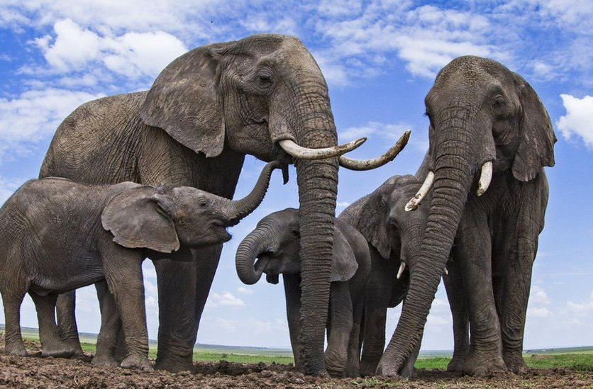
For interactive graphics, download the PPTX version via Interactive Tab

Slide 22
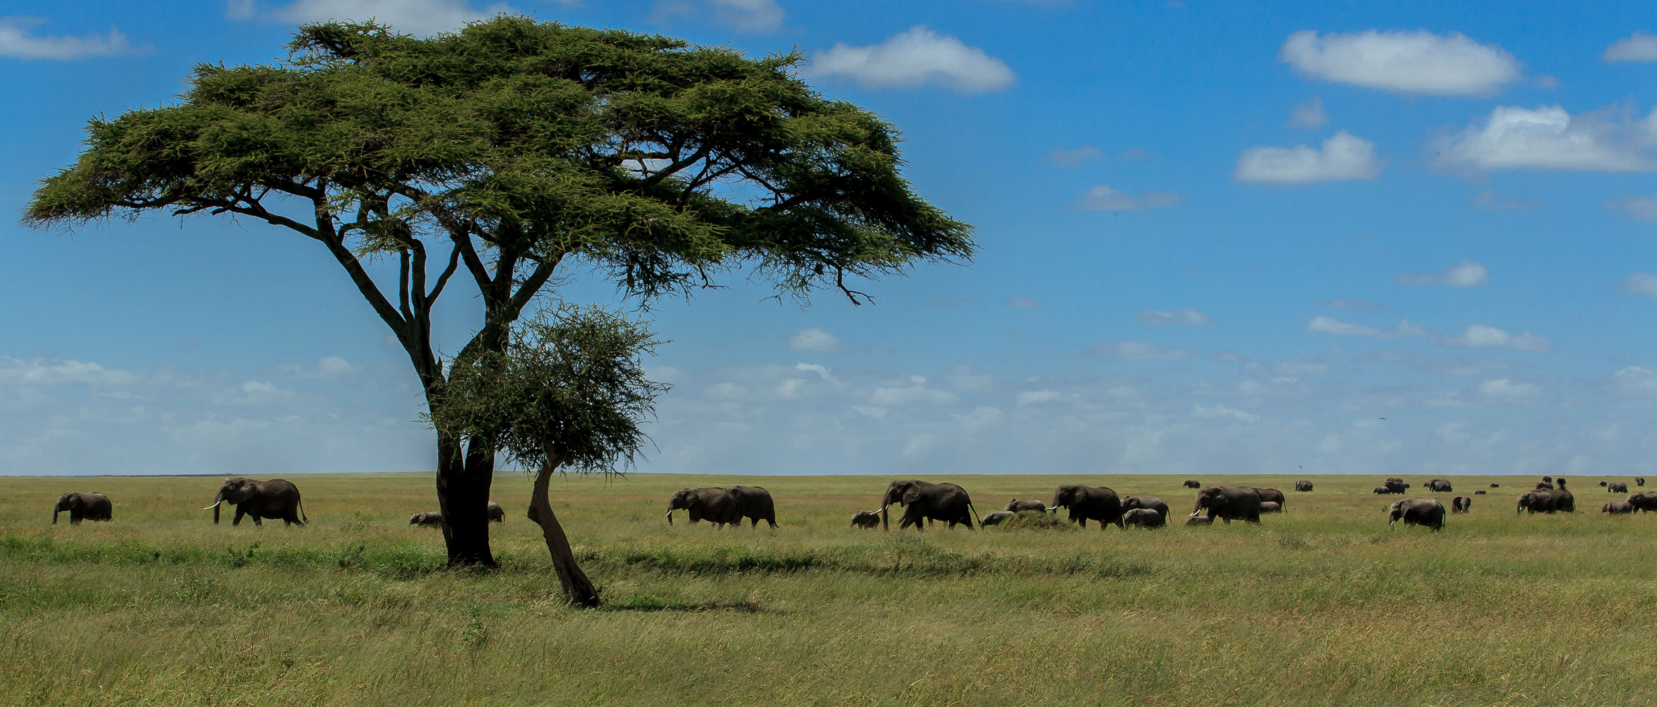
How many unique root words are there in this Noble Surah?
A
None
B
One
C
Two
D
Six

Slide 23
2. The incident of the elephant marked the beginning of which of the following calendars?
A
Gregorian
B
Solar Hijra
C
A’amul Fil
D
Lunar

Slide 24
3. Translation of أَبَابِيلَ is ________________
A
In Flight
B
Little Birds
C
Aggressive Creatures
D
Flock of Birds

Slide 25
4. If one recites Surah al-Fil in their daily prayers, It is an obligatory action to also recite Surah _________ after Al-Hamd because these two count as one and the same Surah.
A
Quraish
B
Teen
C
Ma’un
D
Humaza

Slide 26
5. Surah Fil is the ________ Surah per current compilation and _______ per Revelation.
A
105 ; 18
B
18 ; 105
C
19 ; 105
D
105 ; 19

Slide 27
6. What is another name of Surah Fil?
A
Abraha
B
Alam Tara
C
Abdul Muttalib
D
Ashab

Slide 28
7. What was the name of the Christian king in Abyssinia?
A
Najashi
B
Aryat
C
Abraha
D
Zu Niwas

Slide 29
8. What was the name of the church that Abraha built?
A
Al Aqsa
B
Bait al Fil
C
Al Qoolays
D
Ka’ba of Abyssinia

Slide 30
9. What was the name of the biggest elephant who refused to attach Ka’aba?
A
Suqaif
B
Mahmood
C
Tabriz
D
Dhul Qarnain

Slide 31
10. The flock of birds, that looked like a black cloud, came from the direction of __________________
A
Caspian Sea
B
Arabian Sea
C
Black Sea
D
Red Sea

Slide 32
11. Each bird in the flock carried stones in ___________________
A
Beaks
B
Beaks and feet
C
Feet
D
Under the wings

Slide 33
12. Abraha built a _______________ in Yemen.
A
Church
B
Mosque
C
Temple
D
Synagogue

Slide 34
13. “Hijara” means ________________
A
Feet
B
Beaks
C
Wings
D
Stones

Slide 35
14. “Sijjeel” means ___________________
A
Cloud
B
Flight
C
Sand/Clay
D
Pelting

Slide 36
Hazrat Abdul Muttalib, who had an intense dialog with Abraha, was
the _______________ of our Holy Prophet (S).
A
Paternal Grand father
B
Maternal Grand father
C
Cousin
D
Uncle

