Slide 1
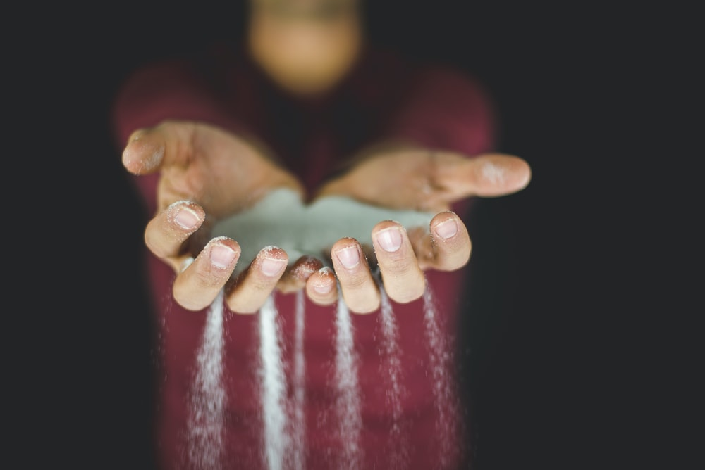

Slide 2
OATH
وَالۡعَصۡرِ
By the time!

Slide 3
STATEMENT
اِنَّ الۡاِنۡسَانَ لَفِىۡ خُسۡرٍ
(is) surely in
loss
mankind
Indeed

Slide 4
EXCEPTION
اِلَّا الَّذِيۡنَ اٰمَنُوۡا وَ عَمِلُوا الصّٰلِحٰتِ وَتَوَاصَوۡا بِالۡحَقِّ وَتَوَاصَوۡا بِالصَّبۡرِ
Righteous deeds
And do
Believe
Those who
Except
To the
patience
To the
truth
And enjoin
And enjoin

Slide 5
COMPOSITION
Compilation
103
Revelation
13
Ayah
3
Words /Letters
14 / 73
Juz
30
Rev. Period
Early Makkan
Names
AL-ASR Time
WAL-ASR
By the time

Slide 6
CONTENT
Ayah 01
Swearing by the hardships of the believers of the time of the Prophet (S)
Ayah 02
The man is in loss
Ayah 03
Factors of human's deliverance from loss and destruction

Slide 7
MERITS
It is transmitted from the Prophet (S) that whoever recites this surah will find his destiny in patience and tolerance; and on the Day of Judgment, he will be resurrected with the companions of the truth.
"He who recites (Surah) 'Asr, in his optional prayers, Allah will raise him with a shining, bright face, cheerful features, and delighted eyes (looking upon the blessings of Allah), until when he enters Paradise on the Day of Judgement.”

Slide 8
FACTS
Surah al-‘Asr is the second shortest surah after al-Kawthar yet bears one-third of the message of the Holy Qur’an.
This is one of the surahs that begin with an Oath. An Oath is used for something:
Sacred
Powerful
Awe inspiring / Magnificent.
Teaches us that TIME is the greatest evidence of loss and the witness of one’s life works.

Slide 9
AYAH 01
Wa: Letter of Oath
Asr: Time (particularly time that is running out) Asr prayers are done during the last part of the day, when the day is running out.
Aseer: (That which is) squeezed out – Asr is thus referred to the Time that is squeezed out of your hands.

Slide 10
TIMES IN QUR’AN
- وَالصُّبْحِ إِذَا أَسْفَرَ - was-subhi idha asfar By the Morning as it brightens [Muddathir 74:34]
- وَالْفَجْرِ - wal fajri I swear by the Dawn. - [Fajr 89:1]
- وَالضُّحَىٰ - wad-duha By the Morning Sun. - [Duha 93:1]
- وَالنَّهَارِ إِذَا تَجَلَّىٰ - wan-nahari idha tajal-la By the Day when it is Brilliant. [al Layl 92:2]
'Asr is a time associated with urgency. Allah is saying that NOW is the time of Emergency. The sunset of our life is passing by. The ending of our day/life is coming soon.

Slide 11
AYAH 02 INSAN
Allah has used the term, INSAAN, instead of NAAS.
Insaan is used for singular as well as plural.
Emphasizing to each and every individual, forgetful human being, (Insaan comes from Nisyaan), you are in loss [in potential trouble].
Insaan was used in ayah 2; which is singular [yet can also imply plural] - so people think individually about themselves being in loss. If it were plural (al Naas) - the human would think someone else is in loss [diffusion of responsibility].
Even though singular human (insan) was mentioned, it implies every single human - individually - is in loss.

Slide 12
AYAH 02 KHUSR
The taNween at the end of KhusriN makes it an “INCREDIBLE” Loss.
Allah has depicted that human are so preoccupied by their personal problems and have completely immersed themselves in their own problems, that they forget that the hardship they have in this life is nothing compared to the one that will come in the next life.
When you forget the next life - you exaggerate in your worry about the problems of this life. Which puts you in loss, in addition to further loss of not preparing for the next life.

Slide 13
AYAH 03
TRAITS required for SALVATION
1. To have firm faith in one’s heart.
2. To perform righteous deeds.
3. To advise one another to follow the truth.
4. To counsel one another to be patient in adversity.
The word wa (which means ‘and’) between each of the 4 conditions denotes that all four are necessary for success.

Slide 14
AYAH 03
KEYWORDS
Fi’l: Action without Intent
‘Aml: Action with Intent
Tawasau: To leave a will - for a loved one.
In a Wasiyya: You leave important message because you are about to die and don't have a lot of time left on hand. The people need to hear your last words that signify sincere and loving advice that is filled with urgency and truth.

Slide 15
SUCCESS
When the companions of the Prophet (S) used to meet one another, they departed only after one of them recited Surah al ‘Asr to the other and they bid peace upon one another. They did not want to forget or become heedless of the essential message of success.

Slide 16
PICTORIAL DEPICTION OF AYAH 03
Surah al ‘Asr
Emaan?
NO
YES
‘Aml-us- Saleh
NO
The word wa (which means ‘and’) between each of the 4 conditions denotes that all four are necessary for success.
YES
KHUSR
Tawasi Bil Haqq
NO
YES
Tawasi Bis Sabr
NO
YES
FALAH

Slide 17
QUIZ
TIME

Slide 18
How many ayah are there in Surah al ‘Asr?
A
Two
B
Three
C
Four
D
Six
01

Slide 19
Surah Asr is the 2nd shortest surah of the Holy Qur’an after Surah …
A
Naas
B
Tawheed
C
Kawthar
D
Falaq
02

Slide 20
Surah Asr is classified as the______ Surah.
A
Early Makkan
B
Mid Makkan
C
Late Makkan
D
Madani
03

Slide 21
By revelation, Surah Asr is the _______ surah revealed to our Holy Prophet (S).
A
10th
B
11th
C
12th
D
13th
04

Slide 22
In which ayah of this surah, has Allah mentioned that the man is in loss?
A
First
B
Second
C
Third
D
Fourth
05

Slide 23
Which of the following has appeared in this surah as the letter of Oath?
A
Wa
B
Al
C
La
D
Fi
06

Slide 24
Allah has sworn by many different instances of times in the Holy Qur’an. Which of the following is not one of them?
A
Fajr
B
Asr
C
Nahar
D
Isha
07

Slide 25
The root word for insaan is Nisyan, which means …
A
To humiliate
B
To err
C
To forget
D
To boast
08

Slide 26
How many traits for salvation are mentioned in the 3rd ayah of this surah?
A
Two
B
Three
C
Four
D
Five
09

Slide 27
Which of the following is an action without intent?
A
‘Aml
B
Fi’l
C
Khusr
D
Tawasau
10

Slide 28
ANSWERS
1 B
2 C
3 A
4 D
5 B
6 A
7 D
8 C
9 C
10 B
https://www.tazkira.info

